Slide 1

Hello World Introduction to R
Dr. Roni Ramon-Gonen

Slide 2

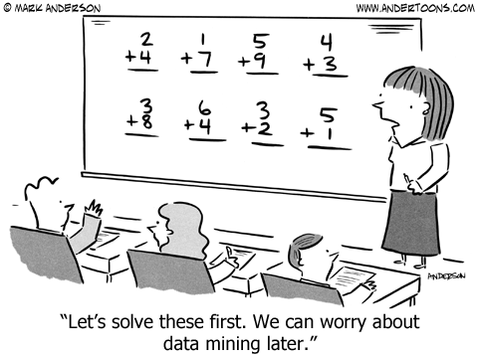
Introduction

Slide 3
What is R?
Initiated in the Bell Laboratories in 1970
Programming language, simple, clean
Excellent for Statistics and Data Analytics
Free software, GNU license
Can run on Windows, Unix, Mac OS

Slide 4
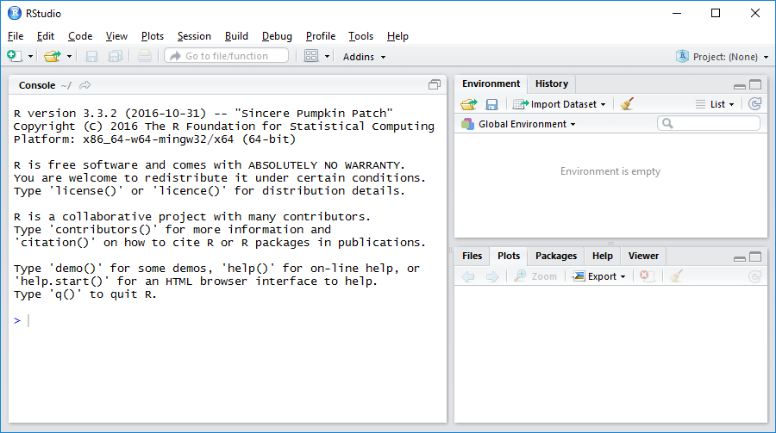
Let Us Open R-Studio

Slide 5

The Very Basic: Variables
comment
# textual variables
txt <- "Hi there"
# numeric variables
x <- 8
y <- 9
result <- 8+9
# vector
vec <- c(3, 4, 9)
vec*2
vec[2]
R command
Class convention:
R code in blue
Running man = run the code lines!

Slide 6
The Very Basic: Variable Types
# conversions
var_c <- "1"
class(var_c)
var_n <- as.numeric(var_c)
class(var_n)

Slide 7
The Very Basic: Factors
# from text to factor (nominal variable)
vec <- c("c", "a", "b", "a", "c")
class(vec)
fct <- as.factor(vec)
vec
class(fct)

Slide 8
if - else Statement
a <- 5
if (a<7) {
a <- a*2
} else { # optional
a <- a/2
}
# shorter:
a <- ifelse(a<7, a*2, a/2)

Slide 9
Loops
for(i in 1:10) {
print(i*i)
}
i <- 1
while(i<=10){
print(i*i)
i <- i+1
}

Slide 10
Functions
computeSum <- function(a, b, c){
sum <- a+ b+ c
return(sum)
}
computeSum(10, 20, 30)

Slide 11
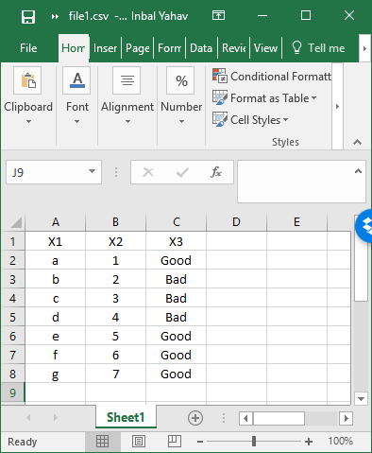
The Very Basic: Read File into data.frame
# set working directory
setwd("C:/Users/user/Desktop/R")
setwd("C:\\Users\\user\\Desktop\\R")
# read file
file.df <- read.csv("file.csv")
# alternative (no need to set working dir)
file.name <- file.choose()
file.df <- read.csv(file.name)
# print file to screen
file.df
head(file.df)

Slide 12
Subsetting the Data
# variable names
names(file.df)
# column selection
file.df[,1]
file.df[,1:2]
file.df[,c(1,3)]
file.df$X2
# row selection
file.df[2:4,]

Slide 13
Subsetting the Data
# advanced
file.df[file.df$X3 == "Good",]

Slide 14
R packages
Package = collection of functions, data, and compiled code
Packages in R:
Come with the software
Contributed by users: https://cran.r-project.org/src/contrib/
Contributes packages:
Advantages: Can find nearly all statistical techniques; New techniques available without delay
Disadvantages: Multiple packages for same use; Potentially Developed by non-experts

Slide 15
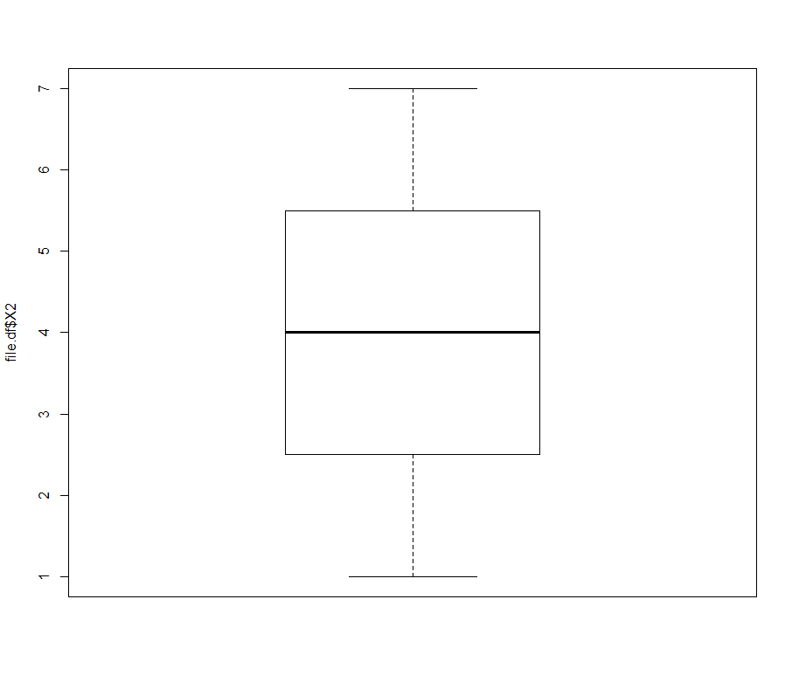
Working with Packages
# install a package (only need to do once)
install.packages("car")
# load the package
library(car)
# use package’s functions
Boxplot(file.df$X2)

Slide 16
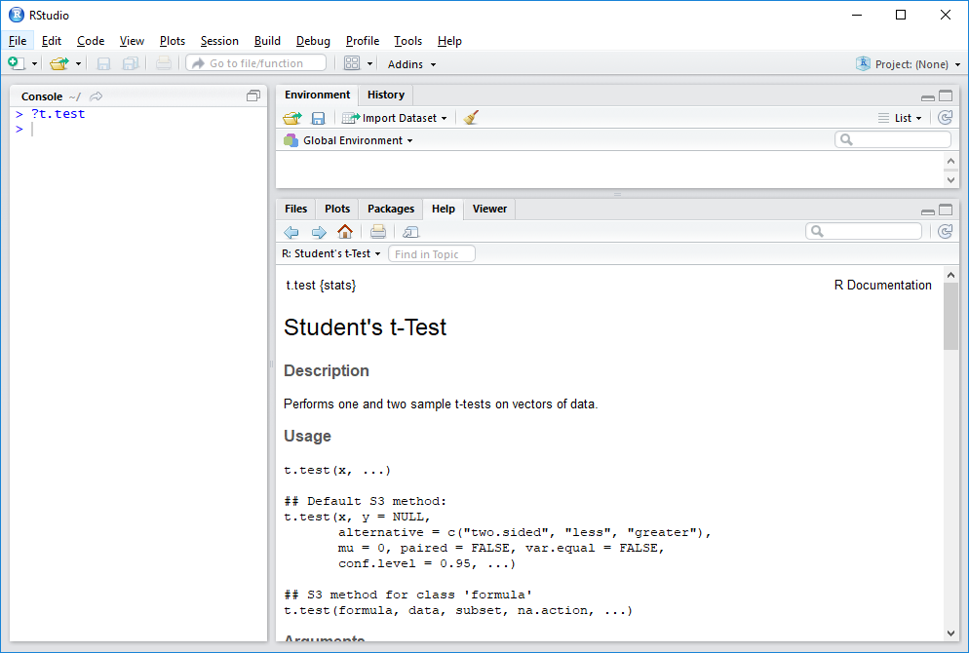
Help

Slide 17
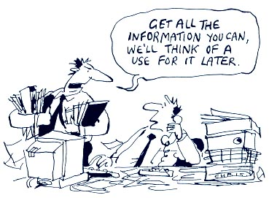
… Next: Data Mining

